Slide 1
Ch-10 Advanced Relationships
A relationship is a connection among things.
In object-oriented modeling, the four most important relationships are dependencies, generalizations, associations, and realizations.
Graphically, a relationship is rendered as a path, with different kinds of lines used to distinguish the different relationships.

Slide 2
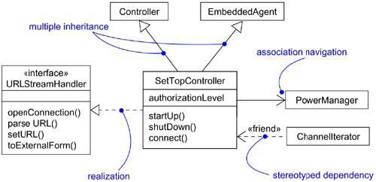
Advanced Relationships

Slide 3
Dependency
A dependency is a using relationship, specifying that a change in the specification of one thing (for example, class SetTopController) may affect another thing that uses it (for example, class ChannelIterator), but not necessarily the reverse.
Graphically, a dependency is rendered as a dashed line, directed to the thing that is depended on.

Slide 4
UML defines a number of stereotypes that may be applied to dependency relationships. There are 17 such stereotypes.
First, there are eight stereotypes that apply to dependency relationships among classes and objects in class diagrams.
1. bind: Specifies that the source instantiates the target template using the given actual parameters.
Bind includes a list of actual arguments that map to the formal arguments of the template.

Slide 5
2. derive: Specifies that the source may be computed from the target.
Use derive when you want to model the relationship between two attributes or two associations, one of which is concrete and the other is conceptual.
3. friend: Specifies that the source is given special visibility into the target.
4. instanceOf: Specifies that the source object is an instance of the target classifier.

Slide 6
5. instantiate: Specifies that the source creates instances of the target.
6. powertype: Specifies that the target is a powertype of the source;
a powertype is a classifier whose objects are all the children of a given parent.
7. refine: Specifies that the source is at a finer degree of abstraction than the target.

Slide 7
8. use: Specifies that the semantics of the source element depends on the semantics of the public part of the target.

Slide 8
There are two stereotypes that apply to dependency relationships among packages.
access: Specifies that the source package is granted the right to reference the elements of the target package.
2. import: A kind of access that specifies that the public contents of the target package enter the flat namespace of the source, as if they had been declared in the source.

Slide 9
Two stereotypes apply to dependency relationships among use cases:
1. extend: Specifies that the target use case extends the behavior of the source.
2. include: Specifies that the source use case explicitly incorporates the behavior of another use case at a location specified by the source.

Slide 10
Three stereotypes when modeling interactions among objects.
1.become: Specifies that the target is the same object as the source but at a later point in time and with possibly different values, state, or roles.
2. call: Specifies that the source operation invokes the target operation.
3. copy: Specifies that the target object is an exact, but independent, copy of the source.

Slide 11
One stereotype in the context of state machines is
send: Specifies that the source operation sends the target event.
Finally, one stereotype that will encounter in the context of organizing the elements of your system into subsystems and models is
trace: Specifies that the target is an historical ancestor of the source

Slide 12
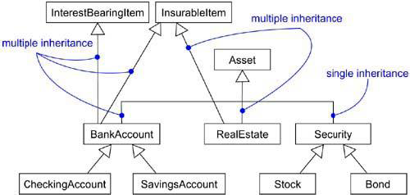
Generalization
A generalization is a relationship between a general thing (called the superclass or parent) and a more specific kind of that thing (called the subclass or child).

Slide 13
Parents, such as InterestBearingItem and InsurableItem, are called mixins because they don't stand alone but, rather, are intended to be mixed in with other parents (such as Asset).
UML defines one stereotype and four constraints that may be applied to generalization relationships.
Implementation: Specifies that the child inherits the implementation of the parent but does not make public nor support its interfaces, thereby violating substitutability.

Slide 14
There are four standard constraints that apply to generalization relationships.
complete: Specifies that all children in the generalization have been specified in the model (although some may be elided in the diagram) and that no additional children are permitted.
incomplete: Specifies that not all children in the generalization have been specified (even if some are elided) and that additional children are permitted.

Slide 15
disjoint: Specifies that objects of the parent may have no more than one of the children as a type.
overlapping: Specifies that objects of the parent may have more than one of the children as a type.
These two constraints apply only in the context of multiple inheritance.

Slide 16
Association
An association is a structural relationship, specifying that objects of one thing are connected to objects of another.
There are four basic adornments that apply to an association: a name, the role at each end of the association, the multiplicity at each end of the association, and aggregation.
other properties you can use to model subtle details, such as navigation, qualification, and various flavors of aggregation.

Slide 17
1. Navigation
Given a plain, unadorned association between two classes, such as Book and Library, it's possible to navigate from objects of one kind to objects of the other kind.
Unless otherwise specified, navigation across an association is bidirectional. There are some circumstances in which we limit navigation to just one direction.

Slide 18
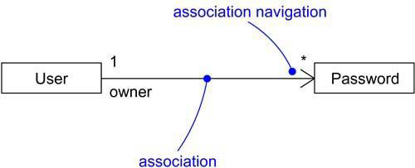
Navigation

Slide 19
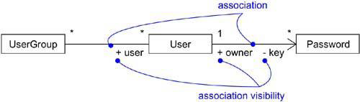
2.Visibility
Given an association between two classes, objects of one class can see and navigate to objects of the other, unless otherwise restricted by an explicit statement of navigation.

Slide 20
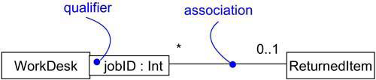
3. Qualification
Given an object at one end of an association, to identify an object or set of objects at the other end.

Slide 21
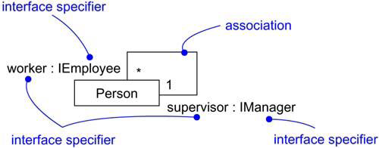
4. Interface Specifier
An interface is a collection of operations that are used to specify a service of a class or a component; every class may realize many interfaces.
Collectively, the interfaces realized by a class represent a complete specification of the behavior of that class.

Slide 22
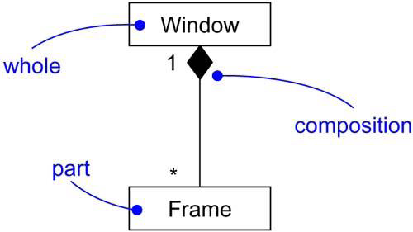
5. Composition

Slide 23
6. Association Classes
In an association between two classes, the association itself might have properties.
For example, in an employer/employee relationship between a Company and a Person, there is a Job that represents the properties of that relationship that apply to exactly one pairing of the Person and Company.

Slide 24
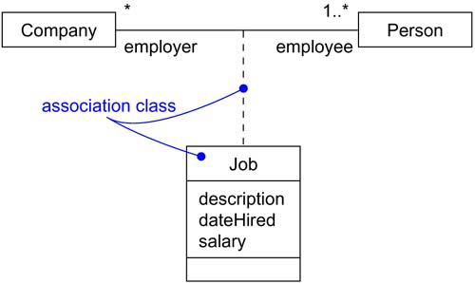
Association Classes

Slide 25
In the UML, you'd model this as an association class, which is a modeling element that has both association and class properties.
An association class can be seen as an association that also has class properties, or as a class that also has association properties.

Slide 26
7. Constraints
UML defines five constraints that may be applied to association relationships.
First, you can distinguish if the association is real or conceptual.
implicit: Specifies that the relationship is not manifest but, rather, is only conceptual.
Second, you can specify that the objects at one end of an association (with a multiplicity greater than one) are ordered or unordered.
2. ordered: Specifies that the set of objects at one end of an association are in an explicit order

Slide 27
Finally, there are three defined constraints that relate to the changeability of the instances of an association.
3.changeable: Links between objects may be added, removed, and changed freely.
4. addOnly: New links may be added from an object on the opposite end of the association.
5. frozen: A link, once added from an object on the opposite end of the association, may not be modified or deleted.

Slide 28
Finally, there is one constraint for managing related sets of associations:
6. xor: Specifies that, over a set of associations, exactly one is manifest for each associated object.

Slide 29
Realization
A realization is a semantic relationship between classifiers in which one classifier specifies a contract that another classifier guarantees to carry out.
Graphically, a realization is rendered as a dashed directed line with a large open arrowhead pointing to the classifier that specifies the contract.

Slide 30
Realization is sufficiently different from dependency, generalization, and association relationships that it is treated as a separate kind of relationship.
You'll use realization in two circumstances: in the context of interfaces and in the context of collaborations.

Slide 31
Realization is used to specify the relationship between an interface and the class or component that provides an operation or service.
An interface is a collection of operations that are used to specify a service of a class or a component.
Therefore, an interface specifies a contract that a class or component must carry out.
An interface may be realized by many such classes or components, and a class or component may realize many interfaces.

Slide 32
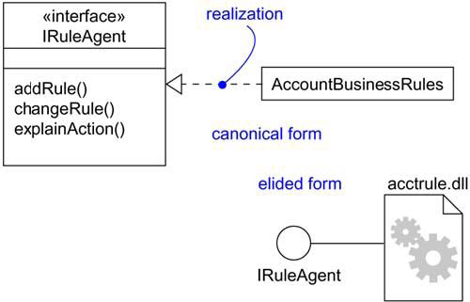
Note that you can represent realization in two ways: in the canonical form (using the interface stereotype and the dashed directed line with a large open arrowhead) and in an elided form (using the interface lollipop notation).
Realization of an Interface

Slide 33
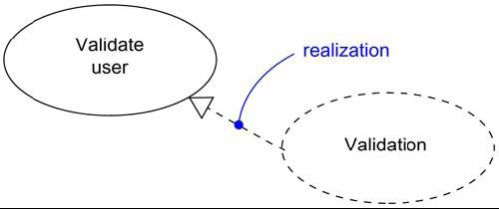
You'll also use realization to specify the relationship between a use case and the collaboration that realizes that use case,
In this circumstance, you'll almost always use the canonical form of realization.
Realization of a Use Case

